Slide 1
TITLE GOES HERE
SUBHEAD
Description
Date

Slide 2
DIVIDER SLIDE

Slide 3
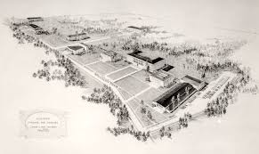
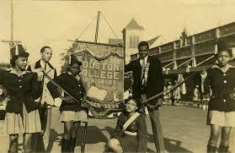
STANDARD SLIDE TITLE | TSU
OUR HISTORY
Houston Colored Junior College (1927-1934)
On September 14, 1927, the Houston Public School Board agreed to fund the development of two junior colleges: one for whites and one for African-Americans under the supervision of the Houston School District. The main provision of the authorization was that the college meet all instructional expenses from tuition fees collected from the students enrolling in the college.
The Colored Junior College was established to provide an opportunity for African-Americans to receive college training. The initial enrollment for the first summer was 300. For the fall semester, the enrollment dropped to 88 students because many of the 300 enrolled during the summer semester were teachers who had to return to their jobs once the school year began.

Slide 4
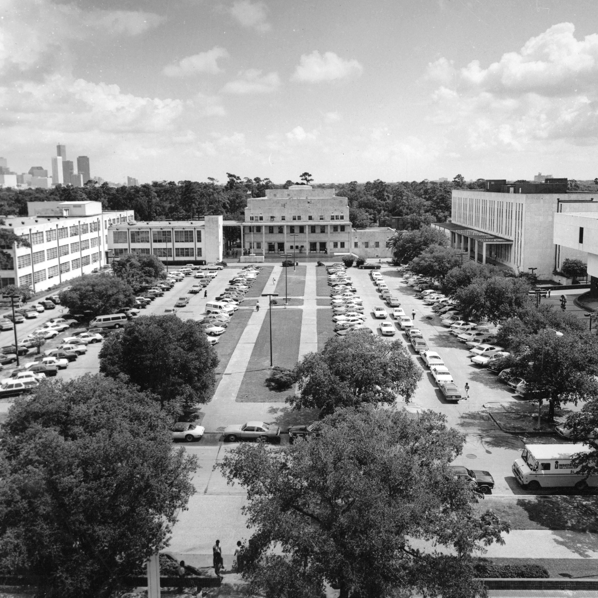
STANDARD SLIDE TITLE | TSU
OUR HISTORY
Texas Southern University (1951-Present)
On June 1, 1951, the name of this new university for Negroes was changed from Texas State University for Negroes to Texas Southern University after students petitioned the state legislature to remove the phrase "for Negroes."
When the university opened its doors in September 1947, it had 2,300 students, two schools, one division and one college - the Law School, the Pharmacy School, the Vocational Division, and the College of Arts and Sciences. Responding to the changing times, in 1973, the 63rd Legislature designated Texas Southern University as a "special purpose" institution for urban programming. As a result, four more academic units were added - the College of Education, the School of Public Affairs, the School of Communications and the Weekend College. This designation described what Texas Southern University was doing from its inception - embracing diversity.

Slide 5
THANK YOU

